Slide 1
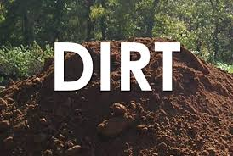
Directed Improvement and Reflection Time
Check through your book and read my comments carefully.
If I have asked a question to extend your work, please respond to this.
If there is any incomplete lesson work to be finished, do so now.
Please also get your homework out (the meaning of Katniss’ name).

Slide 2
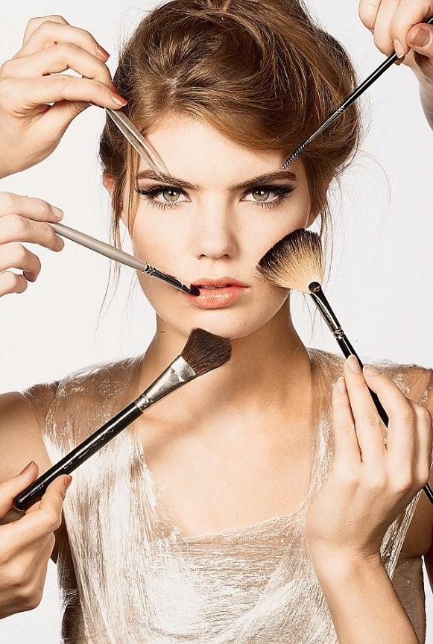
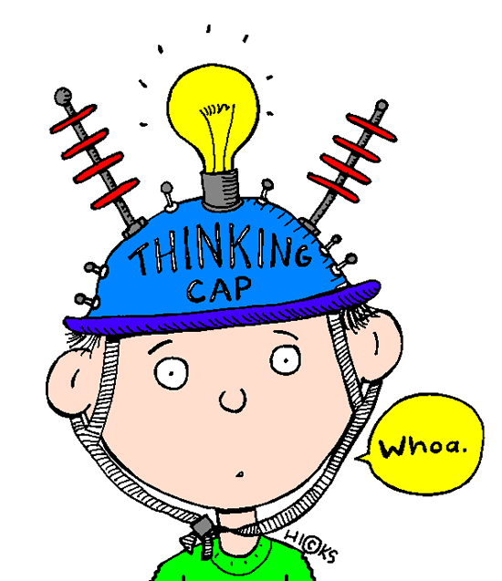
Watch the two videos…
Note down what message you think each is trying to send about the notion of beauty.

Slide 3
Learning Objective
To explore the notion of beauty.
To be able to explain the symbolic importance of Katniss’ costume in the opening ceremony and to have created your own costume.

Slide 4
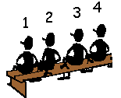
Numbered Heads
You are working in teams!
Number yourselves 1 – 4/5.
You will have 2 minutes to discuss the quotation on the next slide as a team.
After 2 minutes, I will choose a number. That number in each group will share their team’s thoughts with the class.

Slide 5
Q1) What impression of the Capitol does the reader gain from the “aqua hair and gold tattoos?” What are the connotations of the colours?
R-i-i-i-p! I grit my teeth as Venia, a woman with aqua hair and gold tattoos above her eyebrows, yanks a strip of fabric from my leg, tearing out the hair beneath it. “Sorry!” she pipes in her silly Capitol accent. “You’re just so hairy!”
(pg 70)
Q2) What impression is gained by the reader of beauty?
Notes:
Stick on sugar paper, and get pupils to annotate around.

Slide 6
Q1) What is significant about the name “the Remake Centre?” What does this suggest?
I’ve been in the Remake Centre for more than three hours and I still haven’t met my stylist. Apparently he has no interest in seeing me until Venia and the other members of my prep team have addressed some obvious problems. This has included scrubbing down my body with a gritty foam that has removed not only dirt but at least three layers of skin…leaving me like a plucked bird, ready for roasting. (pg 71)
Q2) What impression is gained by the reader of beauty?
Notes:
Stick on sugar paper, and get pupils to annotate around.

Slide 7
Q1) What strikes you about the way Flavius looks? How does this contrast with what he says about Katniss looking like a human being?
“You’re doing very well,” says some guy named Flavius. He gives his orange corkscrew locks a shake and applies a fresh coat of purple lipstick to his mouth. “If there’s one thing we can’t stand, it’s a whiner. Grease her down!” … The three step back and admire their work. “Excellent! You almost look like a human being now!” says Flavius, and they all laugh.
(pg 71-72)
Q2) What impression is gained by the reader of beauty?
Notes:
Stick on sugar paper, and get pupils to annotate around.

Slide 8
Q1) How do you think that Venia and the prep team view natural looks? What can we infer about the Capitol from this quote?
“But don’t worry,” says Venia. “By the time Cinna is through with you, you’re going to be absolutely gorgeous!”
“We promise! You know, now that we’ve got rid of all the hair and filth, you’re not horrible at all!” says Flavius encouragingly.
(pg 72)
Q2) What impression is gained by the reader of beauty?
Notes:
Stick on sugar paper, and get pupils to annotate around.

Slide 9
Task
Write a paragraph analysing the people of the Capitol’s views of beauty, using what we have discussed in this task.
Remember to include a quotation to support your point.
Independent work - Five minutes

Slide 10
Design your own opening ceremony outfit.

